Slide 1
Zonghua Gu
Embedded Systems with ARM Cortex-M Microcontrollers in Assembly Language and C
Chapter 1
Computer and Assembly Language
Zonghua Gu
Fall 2025
Fall 2025
Acknowledgement: Lecture slides based on Embedded Systems with ARM Cortex-M Microcontrollers in Assembly Language and C, University of Maine https://web.eece.maine.edu/~zhu/book/

Slide 2
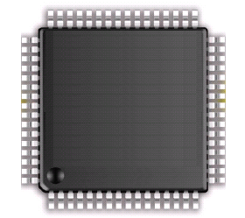
Why ARM processor
ARM: Acron RISC Machine, founded in 1990
Public company, Headquarter at Cambridge, England, UK, 2023 Revenue: US$2.68 billion
Arm processors are used as the main CPU for most mobile phones and handhelds.
The world's second fastest supercomputer (previously fastest) in 2022, the Japanese Fugaku is based on Arm AArch64 architecture
ADC
USB 2.0
DAC
Touch sensing
USART,SPI, I²C
Advanced timers
LCD Driver
Motor control

Slide 3

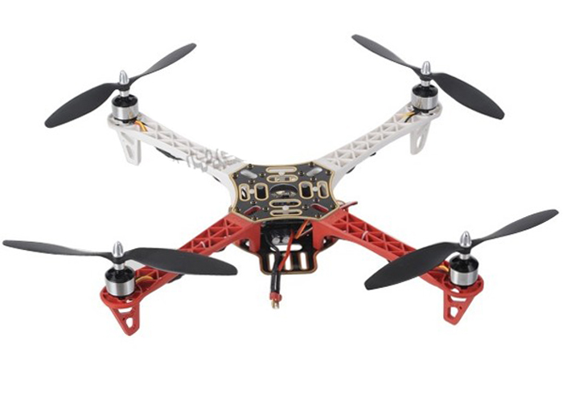
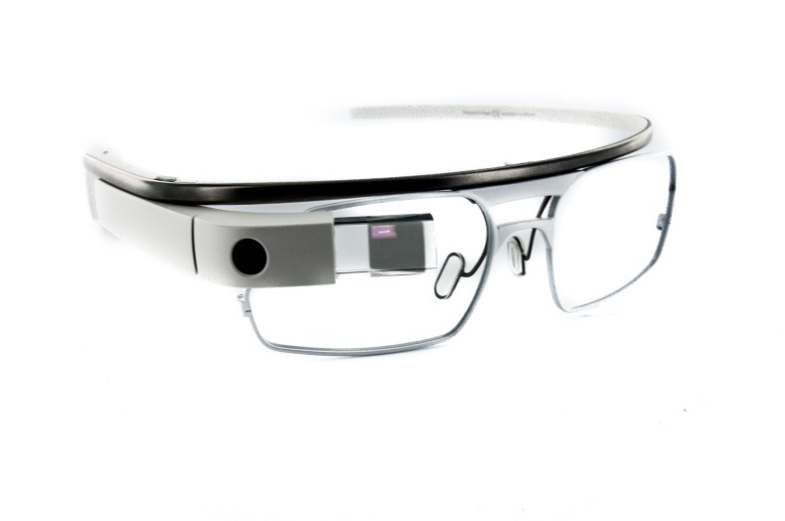
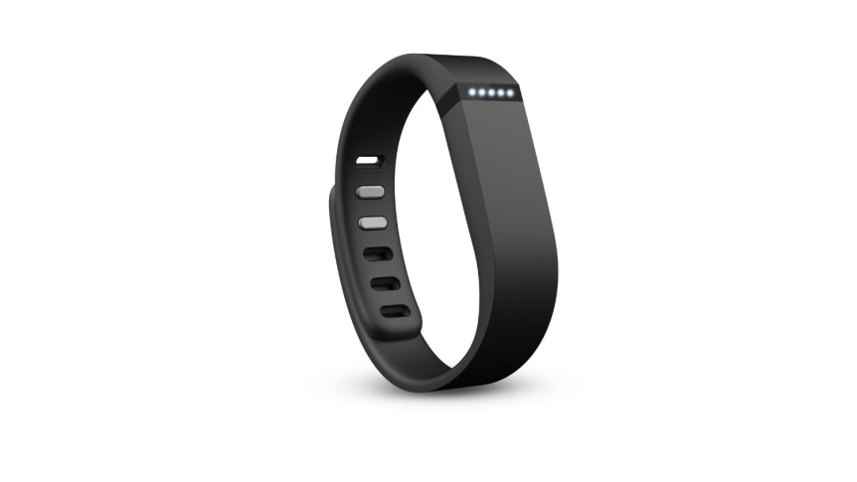
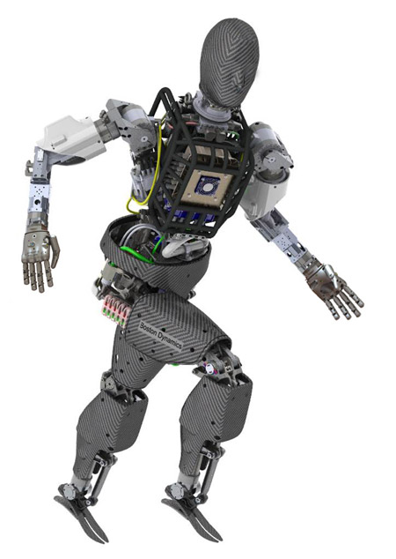
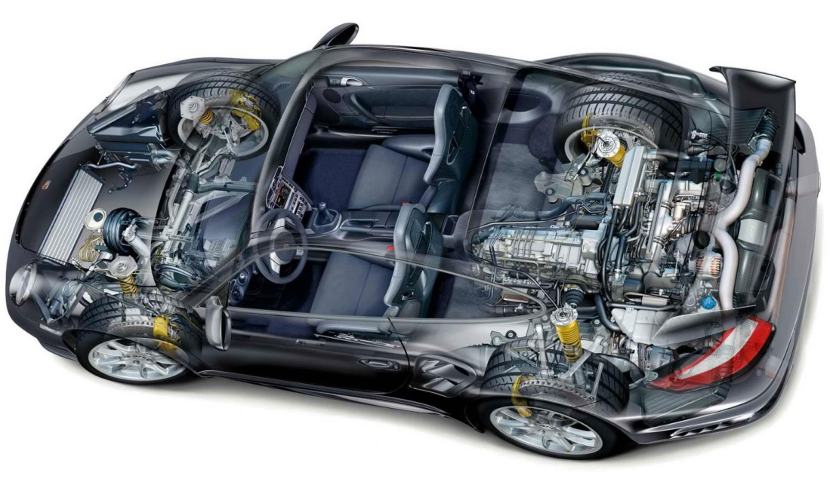
Embedded Systems

Slide 4
Memory
Data
Address
8 bits
32 bits
Memory is arranged as a series of “locations”
Each location has a unique “address”
Each location holds a byte (byte-addressable)
e.g. the memory location at address 0x080001B0 contains the byte value 0x70, i.e., 112
The number of locations in memory is limited
e.g. 4 GB of RAM
1 Gigabyte (GB) = 2³⁰ bytes
2³² locations ➔ 4,294,967,296 locations!
Values stored at each location can represent either program data or program instructions
e.g. the value 0x70 might be the code used to tell the processor to add two values together
0xFFFFFFFF
70
BC
18
01
A0
0x080001B0
0x080001AF
0x080001AE
0x080001AD
0x080001AC
0x00000000
Memory

Slide 5
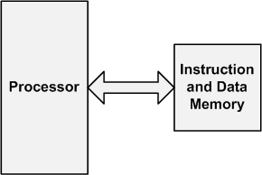
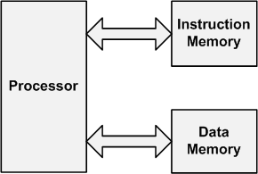
Computer Architecture
Von-Neumann
Harvard
Instructions and data are stored in the same memory.
Data and instructions are stored into separate memories.

Slide 6
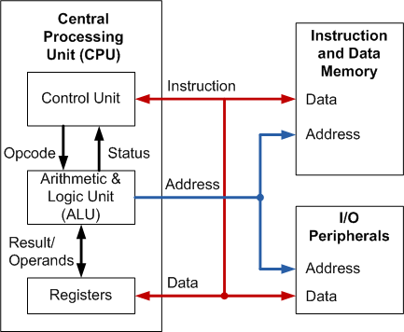
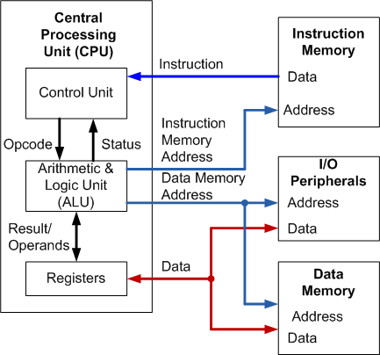
Computer Architecture
Von-Neumann
Harvard
Instructions and data are stored in the same memory.
Data and instructions are stored into separate memories.

Slide 7
von Neumann vs. Harvard
Harvard allows two simultaneous memory fetches.
Most DSPs use Harvard architecture for streaming data:
greater memory bandwidth
more predictable bandwidth
von Neumann allows more flexible placement of instructions and data, hence more efficient memory space utilization

Slide 8
ARM Cortex-M Series Family
Von-Neumann
Harvard
Instructions and data are stored in the same memory.
Data and instructions are stored into separate memories.
ARM
Cortex-M0
ARM
Cortex-M0+
ARM
Cortex-M3
ARM
Cortex-M4
ARMv6-M
ARMv6-M
ARMv7-M
ARMv7E-M
ARM
Cortex-M1
ARM
Cortex-M23
ARM
Cortex-M7
ARM
Cortex-M33
ARMv6-M
ARMv8-M
ARMv7E-M
ARMv8-M

Slide 9
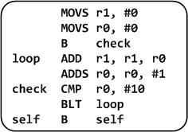
Levels of Program Code
C Program
Assembly Program
Machine Program
0010000100000000
0010000000000000
1110000000000001
0100010000000001
0001110001000000
0010100000001010
1101110011111011
1011111100000000
1110011111111110
int main(void){
int i;
int total = 0;
for (i = 0; i < 10; i++) {
total += i;
}
while(1); // Dead loop
}
Compile
Assemble
High-level language
Level of abstraction closer to problem domain
Provides for productivity and portability
Assembly language
Textual representation of instructions
Human-readable format instructions
Hardware representation
Binary digits (bits)
Encoded instructions and data
Computer-readable format instructions

Slide 10
See a Program Runs
C Code
Assembly Code
int main(void){
int a = 0;
int b = 1;
int c;
c = a + b;
return 0;
}
MOVS r1, #0x00 ; int a = 0
MOVS r2, #0x01 ; int b = 1
ADDS r3, r1, r2 ; c = a + b
MOVS r0, 0x00 ; set return value
BX lr ; return
compiler
assembler
Machine Code
0010000100000000
0010001000000001
0001100010001011
0010000000000000
0100011101110000
2100
2201
188B
2000
4770
; MOVS r1, #0x00
; MOVS r2, #0x01
; ADDS r3, r1, r2
; MOVS r0, #0x00
; BX lr
In Binary
In Hex

Slide 11
Processor Registers
Fastest way to read and write
Registers are within the processor chip
A register stores 32-bit value
ARM Cortex-M has
R0-R12: 13 general-purpose registers
R13: Stack pointer (Shadow of MSP or PSP)
R14: Link register (LR)
R15: Program counter (PC)
Special registers (xPSR, BASEPRI, PRIMASK, etc)

Slide 12
Program Execution
Program Counter (PC) is a register that holds the memory address of the next instruction to be fetched from the memory.
Memory Address
1. Fetch instruction at PC address
4770 2000
188B
2201
2100
0x080001B4
0x080001B2
0x080001B0
0x080001AE
0x080001AC
PC
3. Execute the instruction
2. Decode the instruction
PC = 0x080001B0
Instruction = 188B
Notes:
or
2000188B or 8B180020

Slide 13
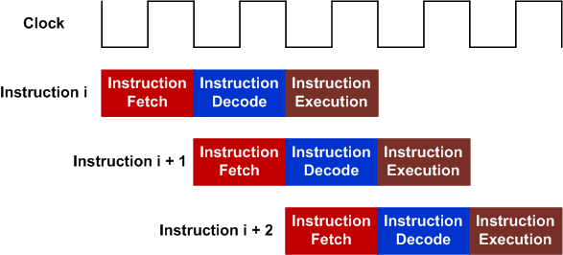
Three-state pipeline: Fetch, Decode, Execution
Pipelining allows hardware resources to be fully utilized
One 32-bit instruction or two 16-bit instructions can be fetched.
Pipeline of 32-bit instructions

Slide 14
Three-state pipeline: Fetch, Decode, Execution
Pipelining allows hardware resources to be fully utilized
One 32-bit instruction or two 16-bit instructions can be fetched.
Pipeline of 16-bit instructions (each instruction fetch
brings in 32 bits, two 16-bit instructions)

Slide 15
Machine codes are stored in memory
Data
Address
r15
pc
0xFFFFFFFF
r14
lr
r13
sp
r12
r11
r10
r9
4770 2000
188B
2201
2100
0x080001B4
0x080001B2
0x080001B0
0x080001AE
0x080001AC
r8
ALU
r7
r6
r5
r4
r3
r2
r1
r0
0x00000000
Registers
CPU
Memory

Slide 16
Fetch Instruction: pc = 0x08001AC Decode Instruction: 2100 = MOVS r1, #0x00
2100 encodes the whole instruction
MOVS r1, #0x00 (details omitted)
Data
Address
r15
0x080001AC
pc
0xFFFFFFFF
r14
lr
r13
sp
r12
r11
r10
r9
4770 2000
188B
2201
2100
0x080001B4
0x080001B2
0x080001B0
0x080001AE
0x080001AC
r8
ALU
r7
r6
r5
r4
r3
r2
r1
r0
0x00000000
Registers
CPU
Memory

Slide 17
Execute Instruction: MOVS r1, #0x00
Data
Address
r15
0x080001AC
pc
0xFFFFFFFF
r14
lr
r13
sp
r12
r11
r10
r9
4770 2000
188B
2201
2100
0x080001B4
0x080001B2
0x080001B0
0x080001AE
0x080001AC
r8
ALU
r7
r6
r5
r4
r3
r2
r1
0x00000000
r0
0x00000000
Registers
CPU
Memory

Slide 18
Fetch Next Instruction: pc = pc + 2
Data
Address
r15
0x080001AE
pc
0xFFFFFFFF
r14
lr
Thumb-2 consists of a mix of 16- & 32-bit instructions
In reality, we always fetch 4 bytes from the instruction memory (either one 32-bit instruction or two 16-bit instructions)
To simplify the demo, we assume we only fetch 2 bytes from the instruction memory in this example.
r13
sp
r12
r11
r10
r9
4770 2000
188B
2201
2100
0x080001B4
0x080001B2
0x080001B0
0x080001AE
0x080001AC
r8
ALU
r7
r6
r5
r4
r3
r2
r1
0x00000000
r0
0x00000000
Registers
CPU
Memory

Slide 19
Fetch Next Instruction: pc = pc + 2 Decode & Execute: 2201 = MOVS r2, #0x01
Data
Address
r15
0x080001AE
pc
0xFFFFFFFF
r14
lr
r13
sp
r12
r11
r10
r9
4770 2000
188B
2201
2100
0x080001B4
0x080001B2
0x080001B0
0x080001AE
0x080001AC
r8
ALU
r7
r6
r5
r4
r3
r2
0x00000001
r1
0x00000000
r0
0x00000000
Registers
CPU
Memory

Slide 20
Fetch Next Instruction: pc = pc + 2 Decode & Execute: 188B = ADDS r3, r1, r2
Data
Address
r15
0x080001B0
pc
0xFFFFFFFF
r14
lr
r13
sp
r12
r11
r10
r9
4770 2000
188B
2201
2100
0x080001B4
0x080001B2
0x080001B0
0x080001AE
0x080001AC
r8
ALU
r7
r6
r5
r4
r3
0x00000001
r2
0x00000001
r1
0x00000000
r0
0x00000000
Registers
CPU
Memory

Slide 21
Fetch Next Instruction: pc = pc + 2 Decode & Execute: 2000 = MOVS r0, #0x00
Data
Address
r15
0x080001B2
pc
0xFFFFFFFF
r14
lr
r13
sp
r12
r11
r10
r9
4770 2000
188B
2201
2100
0x080001B4
0x080001B2
0x080001B0
0x080001AE
0x080001AC
r8
ALU
r7
r6
r5
r4
r3
r2
0x00000001
r1
0x00000000
r0
0x00000000
0x00000000
Registers
CPU
Memory

Slide 22
Fetch Next Instruction: pc = pc + 2 Decode & Decode: 4770 = BX lr
BX lr is “branch-and-exchange” return instruction: it branches to the address held in the link register (lr) and sets execution state
Data
Address
r15
0x080001B4
pc
0xFFFFFFFF
r14
lr
r13
sp
r12
r11
r10
r9
4770 2000
188B
2201
2100
0x080001B4
0x080001B2
0x080001B0
0x080001AE
0x080001AC
r8
ALU
r7
r6
r5
r4
r3
r2
0x00000001
r1
0x00000000
r0
0x00000000
0x00000000
Registers
CPU
Memory

Slide 23
Realities
In the previous example,
PC is incremented by 2
Well, I lied!

Slide 24
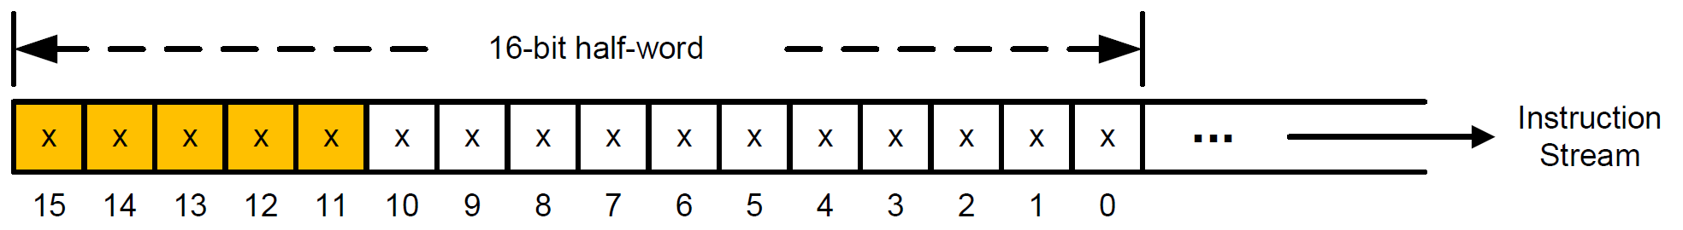
Realities
PC is always incremented by 4.
Each time, 4 bytes are fetched from the instruction memory
It is either two 16-bit instructions or one 32-bit instruction
If bit [15-11] = 11101, 11110, or 11111, then, it is the first half-word of a 32-bit instruction.
Otherwise, it is a 16-bit instruction.

Slide 25
Example: Calculate the Sum of an Array
int a[10] = {1, 2, 3, 4, 5, 6, 7, 8, 9, 10};
int total;
int main(void){
int i;
total = 0;
for (i = 0; i < 10; i++) {
total += a[i];
}
while(1);
}

Slide 26
Example: Calculate the Sum of an Array
Instruction Memory (Flash)
Data
Memory (RAM)
int main(void){
int i;
total = 0;
for (i = 0; i < 10; i++) {
total += a[i];
}
while(1);
}
int a[10] = {1, 2, 3, 4, 5, 6, 7, 8, 9, 10};
int total;
CPU
I/O Devices
Starting memory address
0x08000000
Starting memory address
0x20000000
Notes:
#define __I volatile const /*!< defines 'read only' permissions */
#define __O volatile /*!< defines 'write only' permissions */
#define __IO volatile /*!< defines 'read / write' permissions */

Slide 27
Example: Calculate the Sum of an Array
0010 0001 0000 0000
0100 1010 0000 1000
0110 0000 0001 0001
0010 0000 0000 0000
1110 0000 0000 1000
0100 1001 0000 0111
1111 1000 0101 0001 0001 0000 0010 0000
0100 1010 0000 0100
0110 1000 0001 0010
0100 0100 0001 0001
0100 1010 0000 0011
0110 0000 0001 0001
0001 1100 0100 0000
0010 1000 0000 1010
1101 1011 1111 0100
1011 1111 0000 0000
1110 0111 1111 1110
Instruction Memory (Flash)
MOVS r1, #0x00
LDR r2, = total_addr
STR r1, [r2, #0x00]
MOVS r0, #0x00
B Check
Loop: LDR r1, = a_addr
LDR r1, [r1, r0, LSL #2]
LDR r2, = total_addr
LDR r2, [r2, #0x00]
ADD r1, r1, r2
LDR r2, = total_addr
STR r1, [r2,#0x00]
ADDS r0, r0, #1
Check: CMP r0, #0x0A
BLT Loop
NOP
Self: B Self
int main(void){
int i;
total = 0;
for (i = 0; i < 10; i++) {
total += a[i];
}
while(1);
}
Starting memory address
0x08000000
Notes:
#define __I volatile const /*!< defines 'read only' permissions */
#define __O volatile /*!< defines 'write only' permissions */
#define __IO volatile /*!< defines 'read / write' permissions */

Slide 28
Example: Calculate the Sum of an Array
0x20000054
0x20000050
0x2000004C
0x20000048
0x20000044
0x20000040
0x2000003C 0x20000038
0x20000034
0x20000030
0x2000002C
0x20000028
0x20000024
0x20000020
0x2000001C
0x20000018
0x20000014
0x20000010
0x2000000C
0x20000008
0x20000004
0x20000000
0x00000000
0x00000000
0x00000000
0x00000000
0x00000000
0x00000000
0x00000000 0x00000000
0x00000000
0x00000000
0x00000000
0x00000000
0x0000000A
0x00000009
0x00000008
0x00000007
0x00000006
0x00000005
0x00000004
0x00000003
0x00000002
0x00000001
Data
Memory (RAM)
int a[10] = {1, 2, 3, 4, 5, 6, 7, 8, 9, 10};
int total;
total= 0x00000000
a[9] = 0x0000000A
a[8] = 0x00000009
a[7] = 0x00000008
a[6] = 0x00000007
a[5] = 0x00000006
a[4] = 0x00000005
a[3] = 0x00000004
a[2] = 0x00000003
a[1] = 0x00000002
a[0] = 0x00000001
Assume the starting memory address of the data memory is 0x20000000
Memory
address
in bytes
Memory
content
Notes:
#define __I volatile const /*!< defines 'read only' permissions */
#define __O volatile /*!< defines 'write only' permissions */
#define __IO volatile /*!< defines 'read / write' permissions */

Slide 29
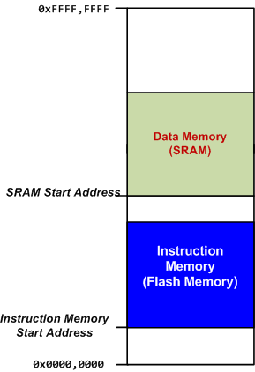
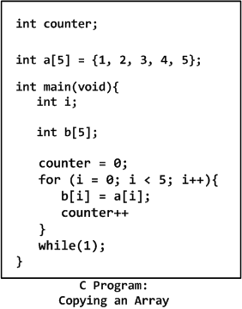

Loading Code and Data into Memory

Slide 30
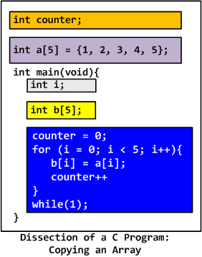
Loading Code and Data into Memory

Slide 31
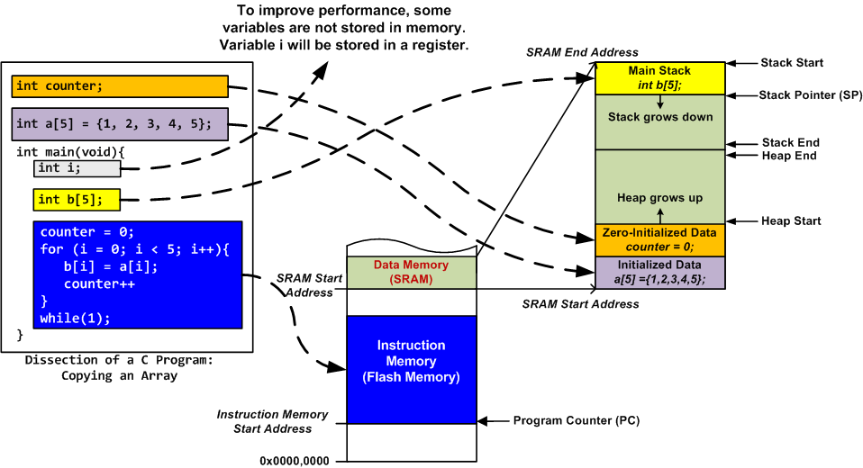
Loading Code and Data into Memory
Stack is mandatory
Heap is used only if dynamic allocation (e.g. malloc, calloc) is used.

Slide 32
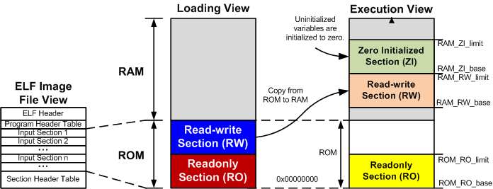
View of a Binary Program

Slide 33
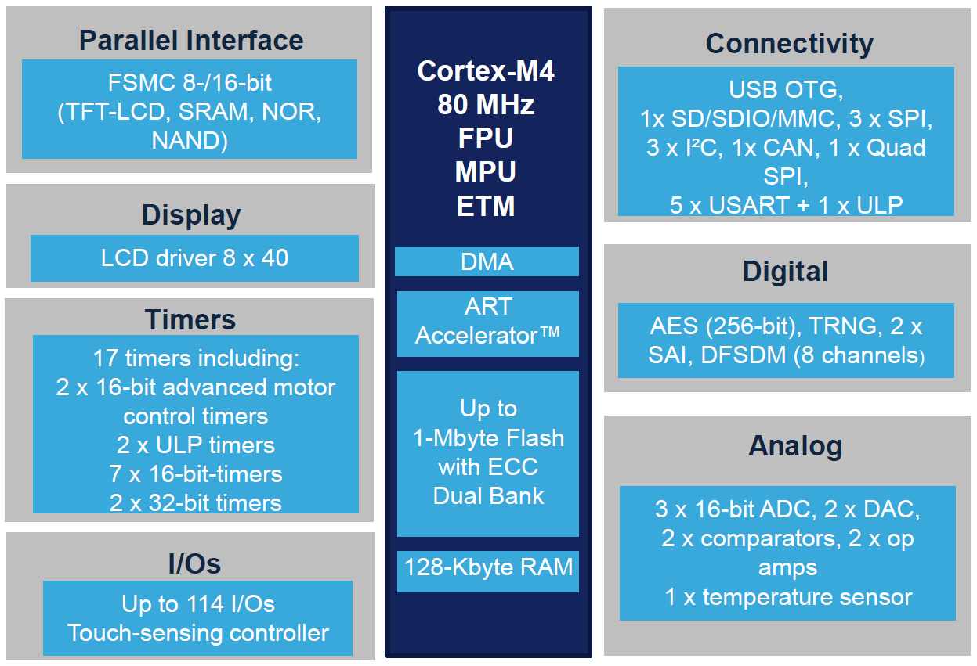
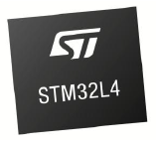
STM32L4
from st.com

Slide 34
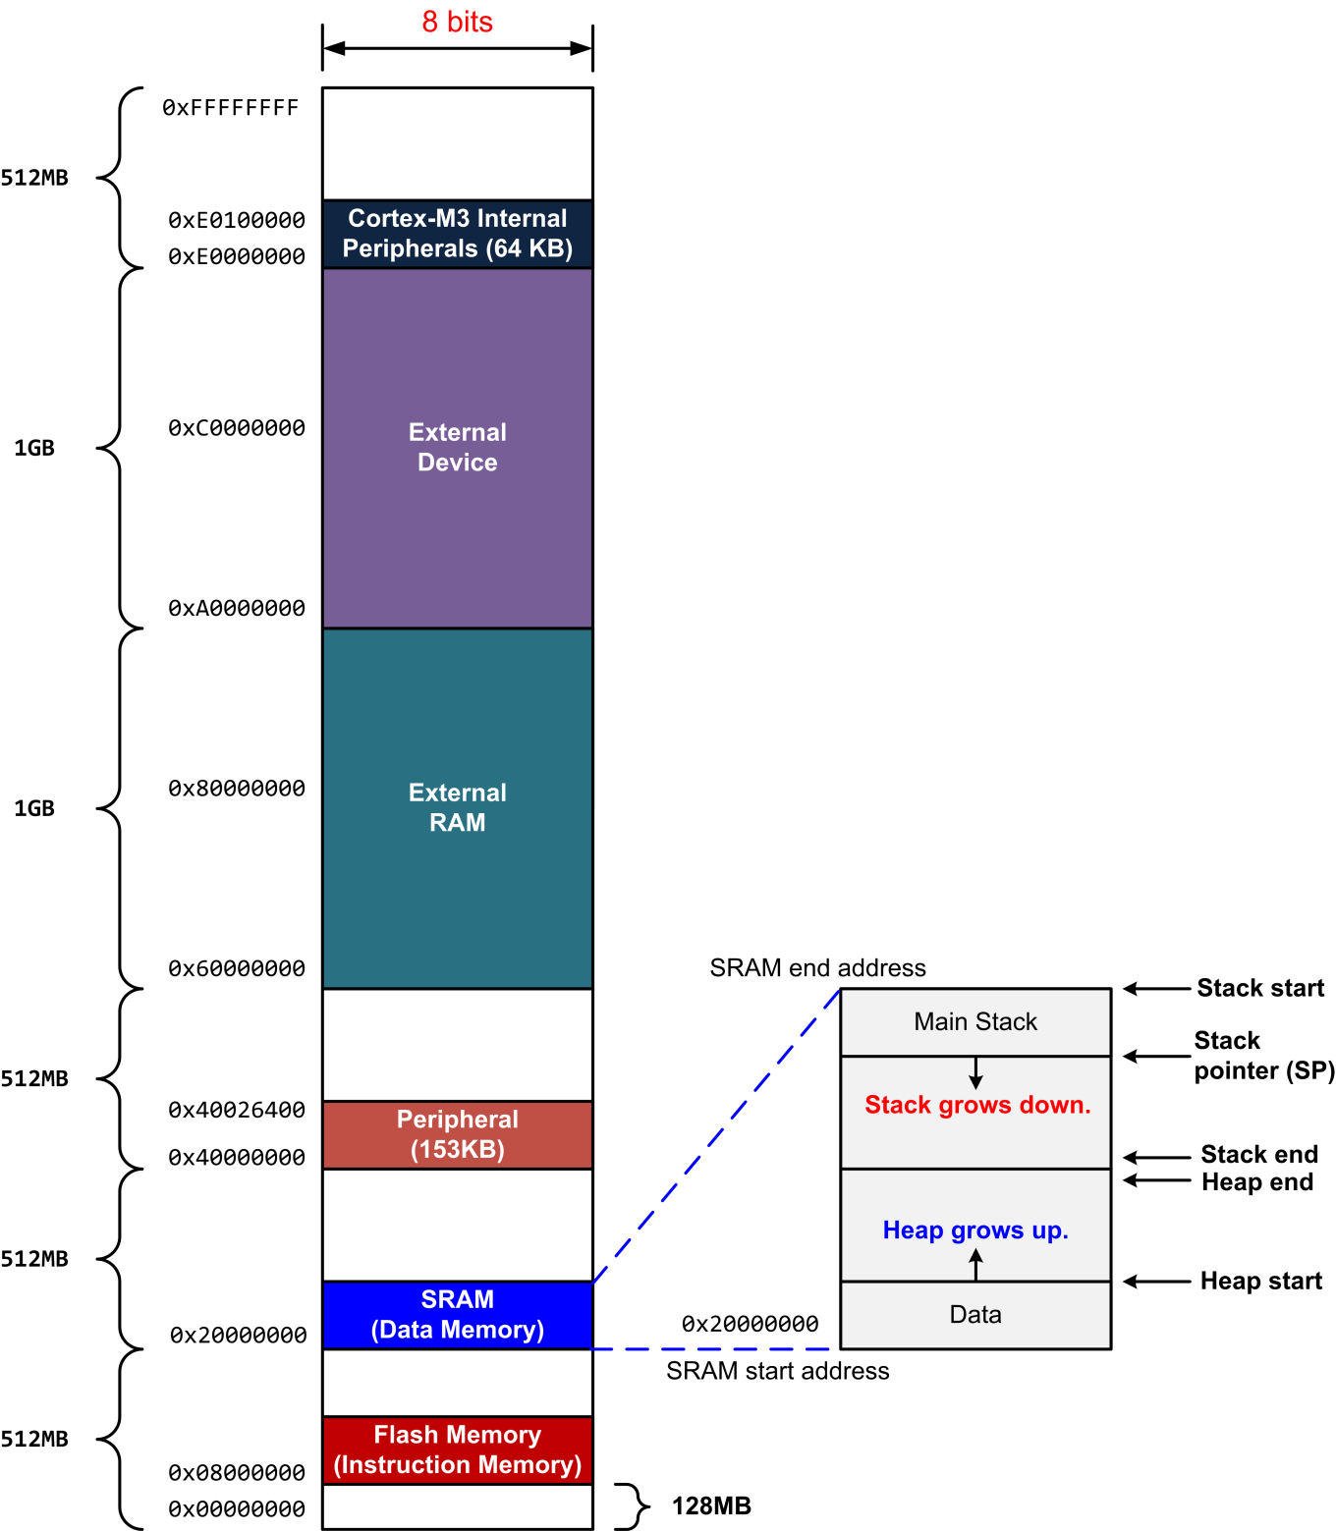
Memory Map

